Slide 1
Enabling Analysis and Visualization of Transportation Big Data at Scale
Stephen Rees, Jonathan Sprinkle, Xia Wang, Matthew Bunting, Dan Work Vanderbilt University
Jonathan W. Lee, Maria Laura Delle Monache, Alexandre M. Bayen
University of California, Berkeley
Benedetto Piccoli
Rutgers University - Camden
DESTION 2025 Irvine, California

Slide 2
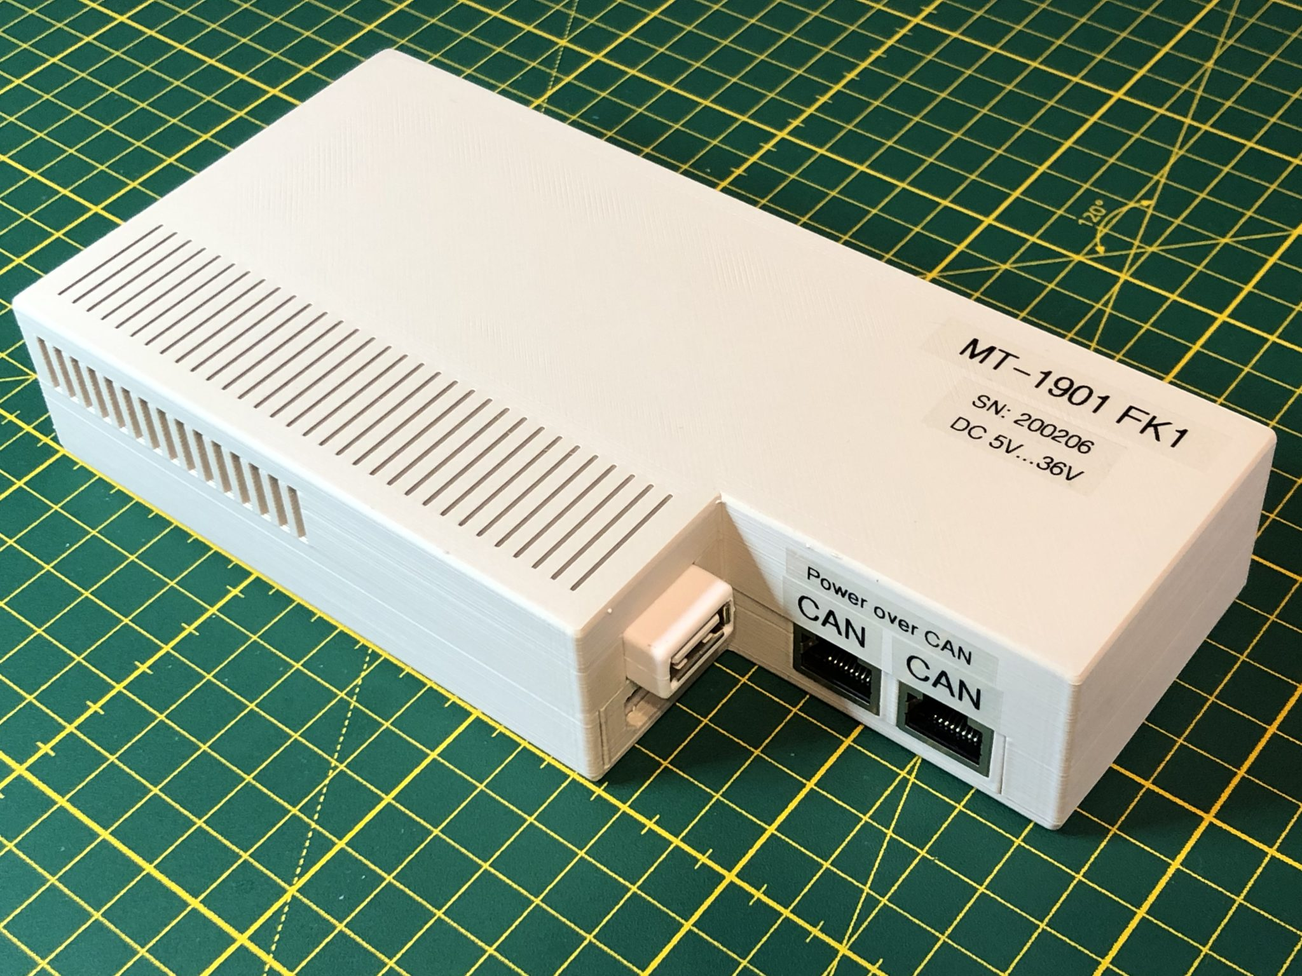
Traffic studies generate a lot of data!
Variety of information formats
Multiple modalities
Mixed frequencies
CAN bus – a few GB/hr*
Video data – 1080p 1.5GB/hr
GPS data – 1 MB/hr @10Hz
Insurance beacons – 100KB/day
Connected vehicle – 25 GB/hr **
* Fugiglando, Umberto et al. “Driving Behavior Analysis through CAN Bus Data in an Uncontrolled Environment” in IEEE Transactions on Intelligent Transportation Systems, Vol 20, No 2, February 2019
** https://www.spglobal.com/mobility/en/research-analysis/briefcase-can-data-privacy-concerns-spoil-connected-car-party.html
DESTION 2025 Irvine, California

Slide 3
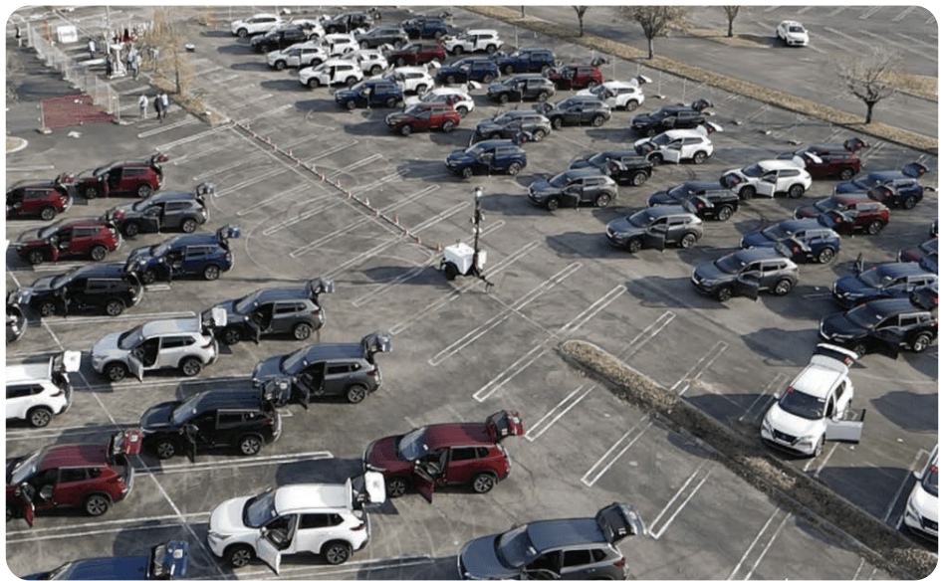
How to manage this?
Single-semester independent study using data from a 100-car experiment* performed by the CIRCLES Consortium on I-24 in Nashville, Tennessee in November 2022
*https://ieeexplore.ieee.org/document/10858622
J. W. Lee et al., "Traffic Control via Connected and Automated Vehicles (CAVs): An Open-Road Field Experiment with 100 CAVs," in IEEE Control Systems, vol. 45, no. 1, pp. 28-60, Feb. 2025, doi: 10.1109/MCS.2024.3498552.
DESTION 2025 Irvine, California

Slide 4
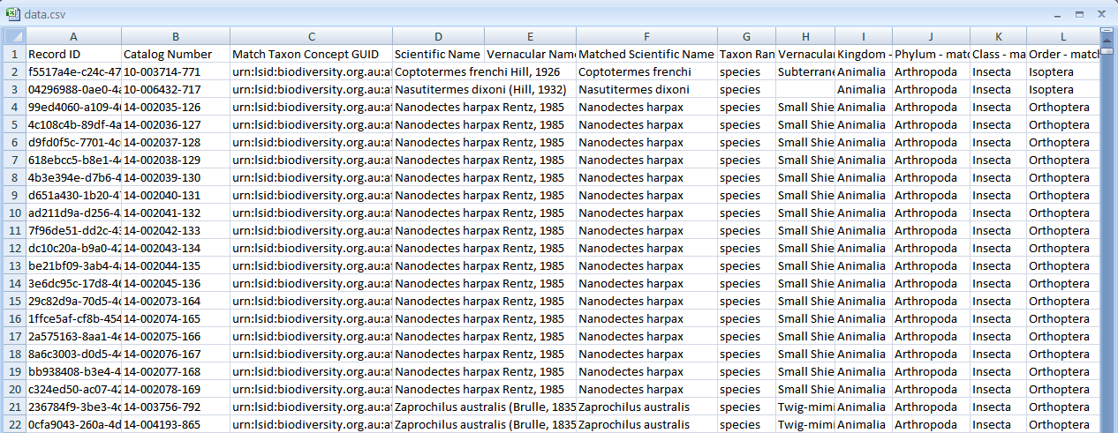

Existing Data
68 GB of multi-modal GPS and CAN bus data collected from 100 vehicles, during morning rush hour over 4 days in one week
Processed into CSV files and chunked to reduce file size; imported into a MySQL database with additional metadata columns
DESTION 2025 Irvine, California

Slide 5
What’s the problem?
Extensive data processing necessary
Difficult to explore
Slow to query
Poor support for mixed-frequency datapoints
Very challenging to visualize the data
DESTION 2025 Irvine, California

Slide 6

Can we?
Simplify storage of the dataset
Better handle mixed-frequency multi-modal data
Improve query speed
Revise analysis routines for efficiency
Enable web-based exploration of data
DESTION 2025 Irvine, California

Slide 7
Most obvious target…
… the database!
MySQL is a fantastic relational database. It is ubiquitous, free and one of the most familiar systems in the world.
There are steps that can be taken to boost its performance, but is it the right platform for our data in the first place?
DESTION 2025 Irvine, California
Notes:
Indexing, data sampling tables, data partitioning, etc

Slide 8

What type of database makes sense for traffic data?
A: Relational
B: Vector
C: Time-Series
D: NoSQL
DESTION 2025 Irvine, California
Notes:
Each of these options has specific benefits that could work very well hand-in-hand to achieve different goals but exploring that far was out of scope for this study.

Slide 9
So many options...
InfluxDB
IoTDB
TimescaleDB
relational
Timescale License (not free for enterprise)
tree-based, tag-based
tag-based
Apache License 2.0
MIT license (cluster not open sourced)
IoTDB claims* to be one of the best options for no-cost, scalable and performant time-series database with an extensive feature set for data exploration and analysis
*https://iotdb.apache.org/UserGuide/V0.13.x/Reference/TSDB-Comparison.html
DESTION 2025 Irvine, California

Slide 10
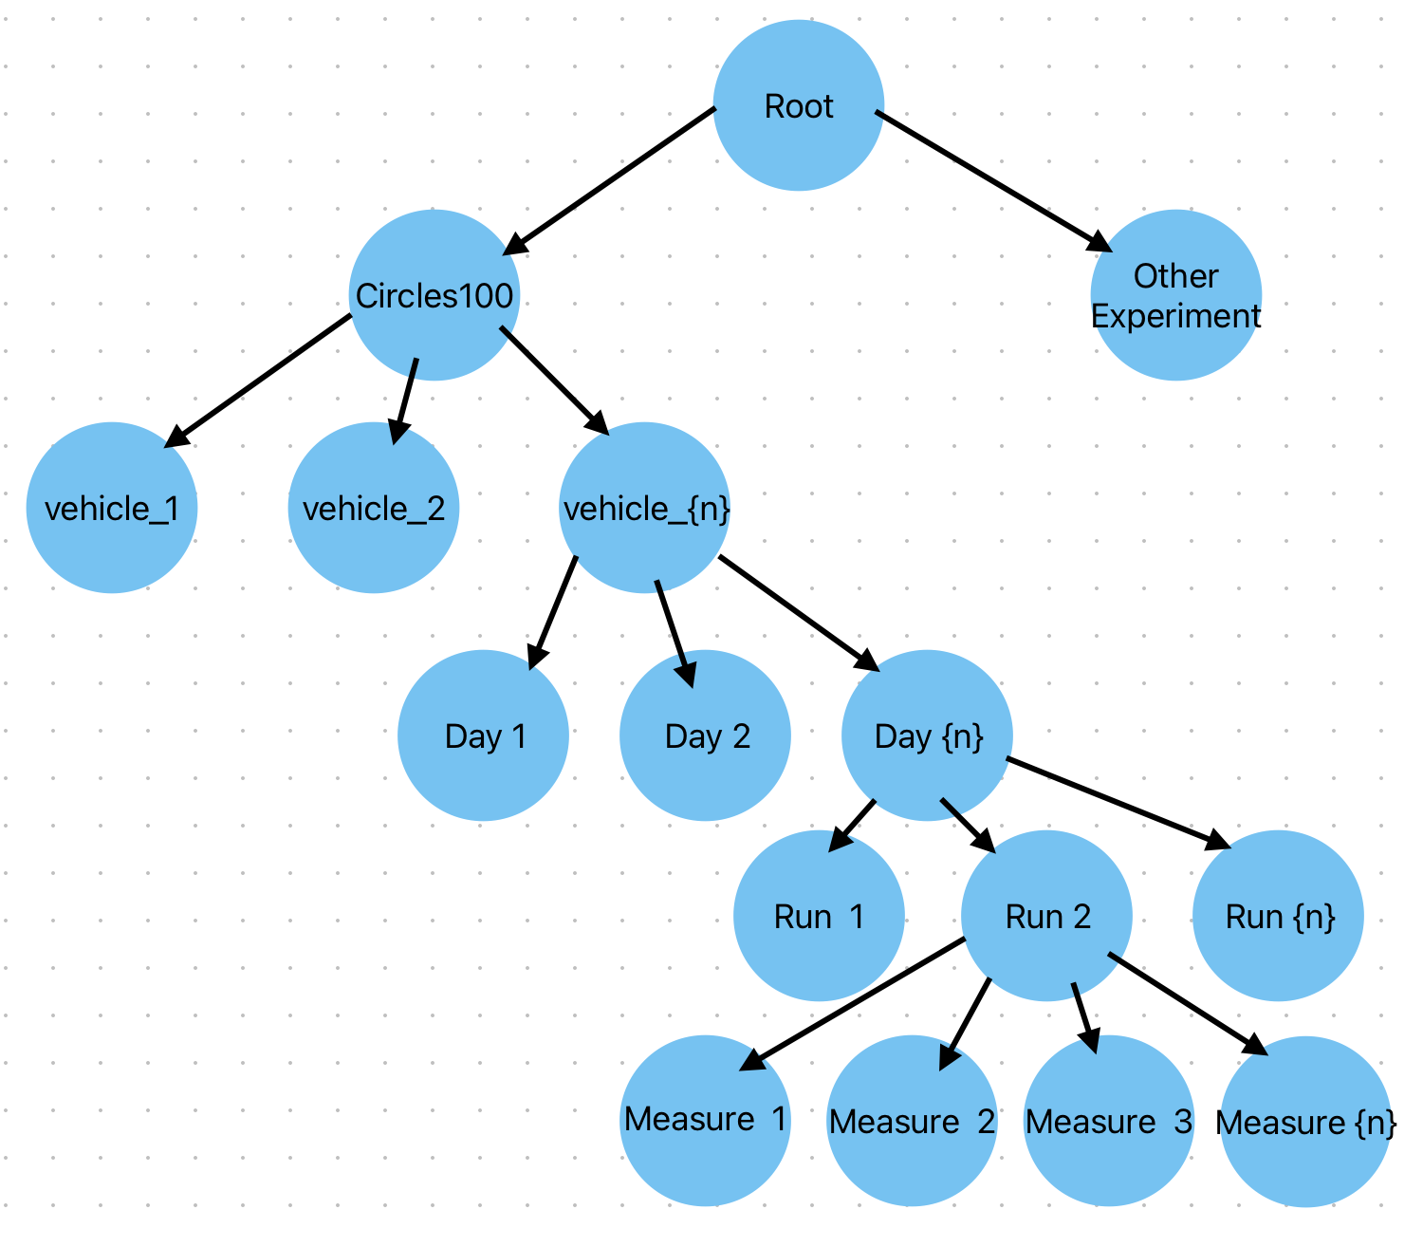
IoTDB schema
root.circles100.vehicle {#}.{YYYY} {MM} {DD}.run {#}.
gps_data_Gpstime
gps_data_Status
gps_data_Long
gps_data_Lat
gps_data_Alt
gps_data_HDOP
gps_data_PDOP
gps_data_VDOP
accel_x_accel_x
acc_hub_set_speed
acc_hub_set_distance
acc_pedal_position_acc_pedal_position
cruise_state_cruise_state
odometer_odometer
speed_speed
steering_wheel_steer_rate
DESTION 2025 Irvine, California
Notes:
While this is where the architecture ended, it is not where it started. Initial work separated out GPS data from CAN bus data as separate time-series. However, this caused problems when we started trying to query data with time alignment that spanned both time series, and it was necessary to reimport the data to fit this design

Slide 11
Import Scripts
Python libraries exist for IoTDB
Custom built scripts had very long run times initially, would take weeks to import data
Switched to batch imports
Isolated and removed redundant DB calls
Implemented email notifications when complete
Used screen sessions to avoid terminal disconnects
Reduced to 1-2 hrs to import 68GB of data
At scale small efficiencies make a big difference!
DESTION 2025 Irvine, California

Slide 12

Query Performance
Simple test…count all records
MySQL:
SELECT
COUNT(*)
FROM
can_decode_message_speed
WHERE
file_tag_id LIKE '%221114%'
60475996 in 13m 53.12s
IoTDB:
SELECT
COUNT(speed_speed)
FROM
root.CIRCLES.*.2022_11_14.*.can_bus_data
GROUP BY LEVEL = 3
60475996 unique records 0.054s
DESTION 2025 Irvine, California

Slide 13
Different record count?
MySQL: 58744420 IoTDB: 60475996
- developed script to verify all records imported (and reimported)
- searched for duplicates (turns out IoTDB inherently will not duplicate rows)
Discrepancy caused by data associated to a single day spanning greater than 24 hours. IoTDB counts the records structured under the date node, MySQL was counting by timestamp.
Corrected MySQL:
SELECT
COUNT(*)
FROM
can_decode_message_speed
WHERE
file_tag_id LIKE '%221114%'
60475996 in 13m 53.12s
DESTION 2025 Irvine, California
Notes:
Having to parse a text field drove this query from 25s to nearly 14m!

Slide 14
Complexity Comparison
Query for speed and set_speed in 2-minute granularity for one car on one date
systime > 1668747600 AND systime <
1668837600,
AND vin_key = 83
) AS speed_intervals
LEFT JOIN
(SELECT
FROM_UNIXTIME(FLOOR(systime / 120) * 120)
AS time_interval,,
set_speed,
ROW_NUMBER() OVER (PARTITION BY
FLOOR(systime / 120),
ORDER BY systime DESC) AS rn
FROM
can_decode_message_acc_hub
WHERE
systime > 1668747600 AND systime <
1668837600,
AND vin_key = 83
) AS acc_intervals
ON
speed_intervals.time_interval =
acc_intervals.time_interval AND,
speed_intervals.rn = acc_intervals.rn
WHERE
speed_intervals.rn = 1
ORDER BY
speed_intervals.time_interval;
100 rows in set (4 min 50.64 sec)
MySQL:
SELECT
speed_intervals.time_interval,
speed_intervals.speed AS last_speed,
acc_intervals.set_speed AS last_set_speed
FROM
(SELECT
FROM_UNIXTIME(FLOOR(systime / 120) * 120)
AS time_interval,,
speed,
ROW_NUMBER() OVER (PARTITION BY
FLOOR(systime / 120),
ORDER BY systime DESC) AS rn
FROM
can_decode_message_speed
WHERE
DESTION 2025 Irvine, California

Slide 15

Complexity Comparison
Query for speed and set_speed in 2-minute granularity for one car on one date
IoTDB:
SELECT
LAST_VALUE(acc_hub_set_speed),
LAST_VALUE(speed_speed)
FROM
root.CIRCLES.vehicle_83.2022_11_18.*.can_bus_data,
GROUP BY
([2022-11-18T00:00:00, 2022-11-18T23:59:59), 2m)
Total line number = 720 It costs 0.722s
DESTION 2025 Irvine, California

Slide 16
Complexity Comparison
Row count mismatch! MySQL: 100 IoTDB: 720
IoTDB returns NULL rows where needed to fill out the time range based on granularity requested.
MySQL returns only rows of data.
DESTION 2025 Irvine, California

Slide 17

We can query the data, and it appears performant. Can we easily reproduce types of graphs from previous reports?
DESTION 2025 Irvine, California

Slide 18
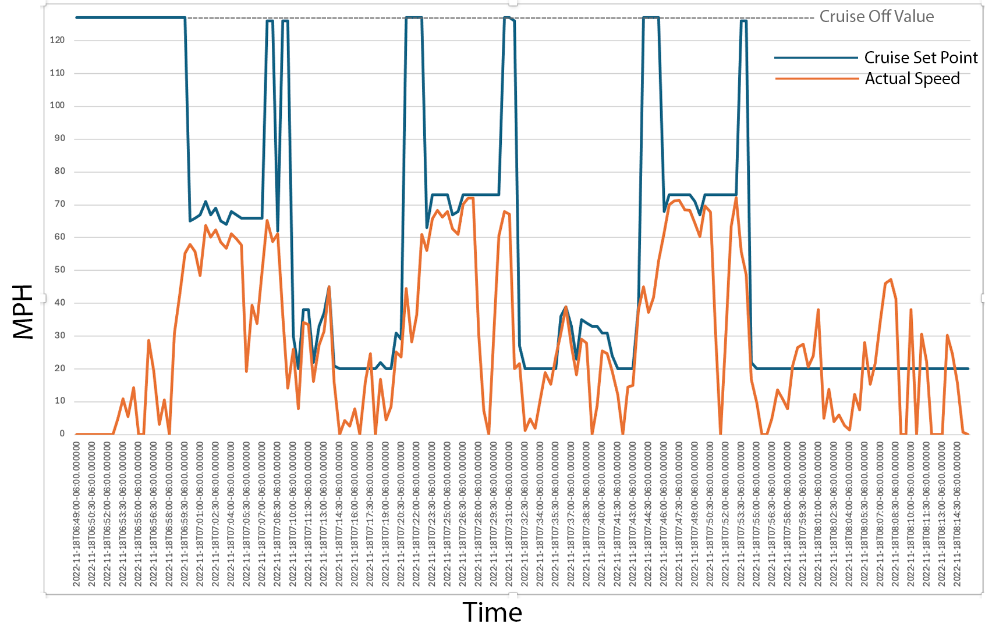
Reproducing Existing Visuals
Excel provided this first one based on data from the last query at 90s intervals Iteration through this very manual process was too slow, so we switched to a Jupyter notebook going forward
DESTION 2025 Irvine, California
Notes:
This is a simple, single vehicle graph running multiple highway loops over a couple hours. Not a difficult query.

Slide 19
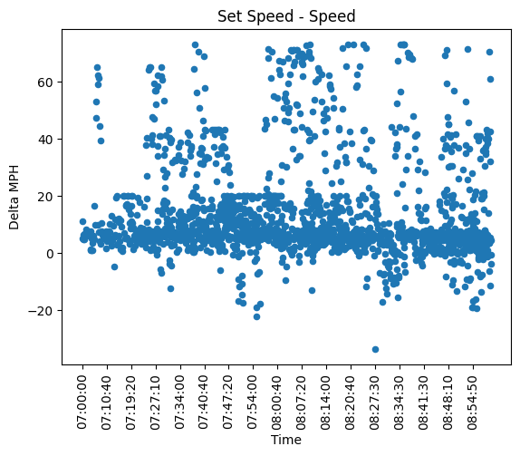
Multiple vehicles query
SELECT AVG(acc_hub_set_speed) -
AVG(speed_speed)*0.621371,
FROM
root.circles100.vehicle_8*.2022_11_17.*
WHERE
cruise_state_cruise_state > 0
AND acc_hub_set_speed BETWEEN 0 AND 120
GROUP BY ([2022-11-17T07:00:00,2022-11-17T08:59:59),
10s),
ORDER BY Time
ALIGN BY DEVICE
23760 records in 0.3319981669774279 seconds dataframe
conversion in 0.22297350002918392 seconds
DESTION 2025 Irvine, California
Notes:
This introduces IoTDB’s Align By Device. We query 11 vehicles over a 2hr period with 10s averaged windows in about a ½ second.

Slide 20
Align By Device
Without using ‘ALIGN BY DEVICE’, IoTDB will generate a Cartesian product across time-series when applying mathematical operations, as well as apply ‘WHERE’ clauses with an ‘AND’ across time-series ALIGN BY DEVICE addresses both issues
DESTION 2025 Irvine, California
Notes:
Not using ’ALIGN BY DEVICE’ gives long execution times and unexpected results

Slide 21
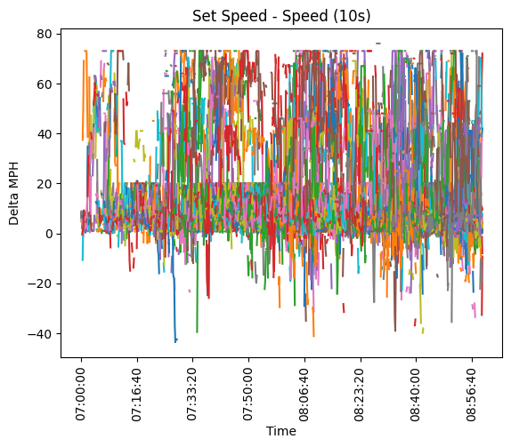
Graph by device
Using Pandas dataframes within Jupyter allows us to pivot the data from the same query and graph by vehicle/run
DESTION 2025 Irvine, California

Slide 22
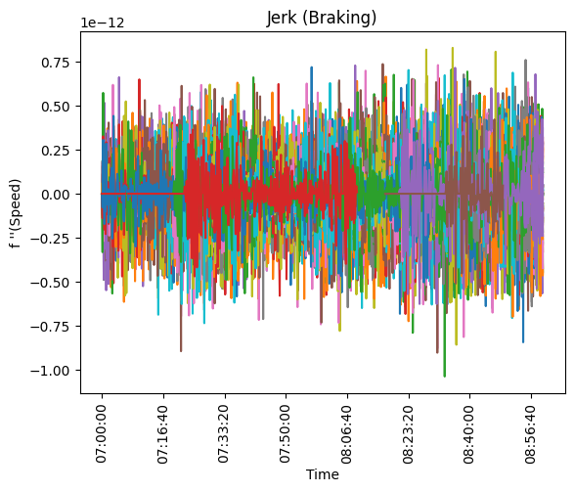
Complex operations
SELECT
derivative(
derivative(
AVG (speed_speed))) AS jerk
FROM
root.circles100.*.2022_11_17.*
GROUP BY ([2022-11-17T07:00:00,2022-11-17T08:59:59),
10s),→
ALIGN BY DEVICE
216720 records in 0.32244883303064853 seconds dataframe
conversion in 2.3397924170130864 seconds
Derivative data is well supported, allowing us to convert from speed to graph acceleration or in this case, jerk. From this we can pull max/min values to explore details of interest.
DESTION 2025 Irvine, California
Notes:
This query is for ALL vehicles on a specific date, in 10s averages over a couple hours. Processing the query and returning the data only took a little over 2 seconds!

Slide 23
Traffic Waves?
Process full data for all vehicles across multiple hours
Factor in direction of travel
Additional dimension for colorizing traces by speed
Translate GPS data to approximate mile marker
Let’s build up to it!
DESTION 2025 Irvine, California

Slide 24

Bearing
Data does not contain direction of travel, only GPS readings. Can IoTDB calculate this for us? The answer is ”sort of” but this may be better to do in the dataframe post query…
DESTION 2025 Irvine, California

Slide 25
Bearing
SELECT
AVG(gps_data_Lat) AS Lat,
AVG(gps_data_Long) AS Long,
ABS(
DEGREES(atan(
ABS(LAST_VALUE(gps_data_Long) -
FIRST_VALUE(gps_data_Long))
/
ABS(LAST_VALUE(gps_data_Lat) -
FIRST_VALUE(gps_data_Lat)),→
))
+jexl(
(LAST_VALUE(gps_data_Long) -
FIRST_VALUE(gps_data_Long)),,→
(LAST_VALUE(gps_data_Lat) -
FIRST_VALUE(gps_data_Lat)),,→
'expr'='(x,y) -> (x < 0 && y >= 0 ? -360 :
(x < 0 && y < 0 ? 180 : (x > 0 && y < 0
? -180 : 0)))'
,→
,→
)
) as Bearing
FROM root.circles100.*.2022_11_17.*
group by
([2022-11-17T07:00:00,2022-11-17T08:59:59),
10s) align by device
,→
,→
239040 records in 0.33727529196767136 seconds dataframe
conversion in 3.454556083015632 seconds
IoTDB does not support the ATAN2 function that is commonly used for this type of calculation. It does however support JEXL for embedding logic in queries. We simulated ATAN2 with a mix of simpler math functions and JEXL This would be a candidate for creating a custom function, which IoTDB supports We later opted to calculate this post hoc with the data frame
DESTION 2025 Irvine, California

Slide 26
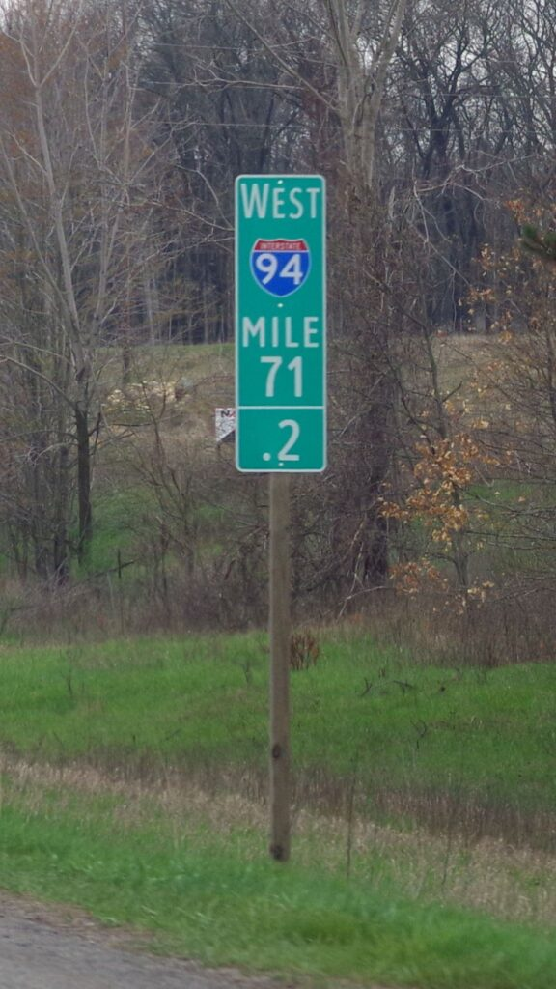
Mile Markers
We already had a separate spreadsheet that has GPS points along the testbed and a mile marker value for those points.
It was necessary to approximate mile marker location by using the nearest data points from that spreadsheet, so this operation is done with the data frame.
Additionally, a function was made available that would use linear interpolation based on inverse distance weighting.
DESTION 2025 Irvine, California

Slide 27
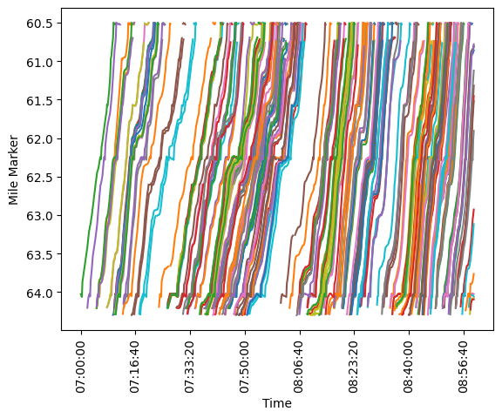
First try…
This attempt left out color by speed and simply shows tracks by vehicle run. It’s rough! Traffic waves are visible, but so are horizontal bars that don’t make sense.
This took a long time – the query and data return was around 3.5 seconds, but the graph took around 80 seconds – far too long for a web-based interface.
DESTION 2025 Irvine, California

Slide 28
Mile Markers
Interpolation was a major performance issue. - distance was calculated for every data point against every mile marker point in the spreadsheet
ChatGPT helped come up with a better option: - spatial interpolation using scipy.spatial KDTree to calculate nearest neighbors
Reduced interpolation from 80 seconds to 0.03 seconds for a quarter million records
DESTION 2025 Irvine, California

Slide 29
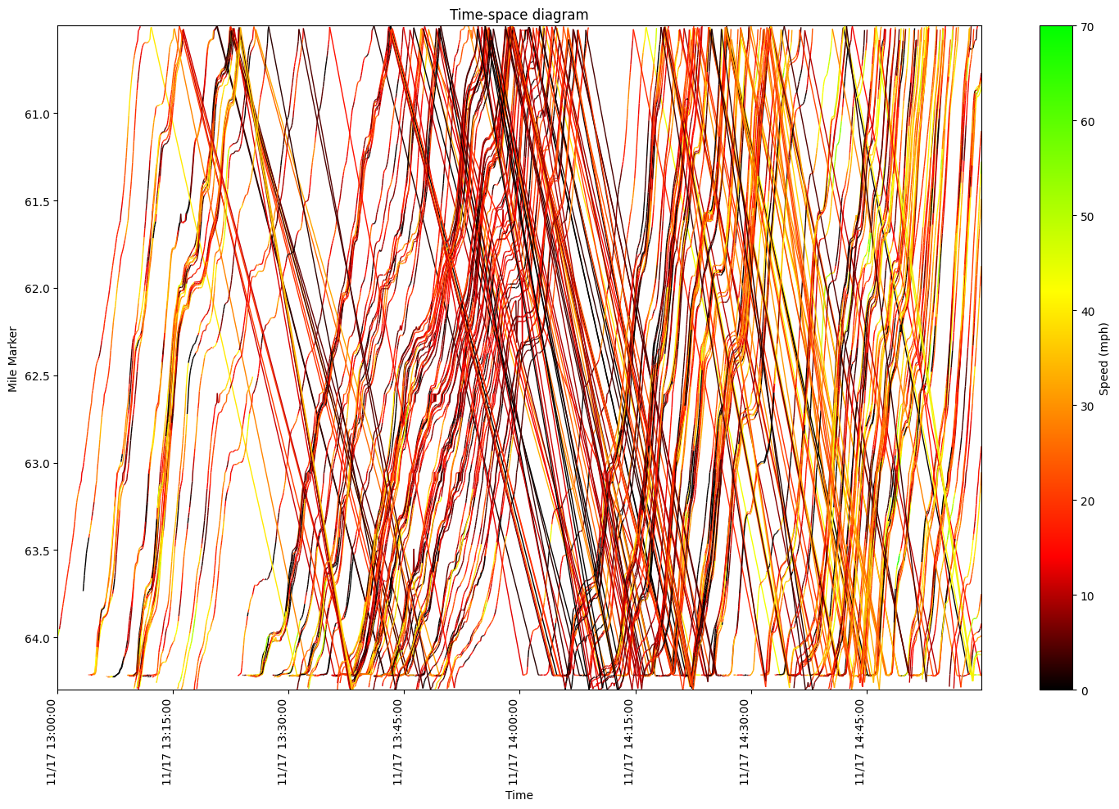
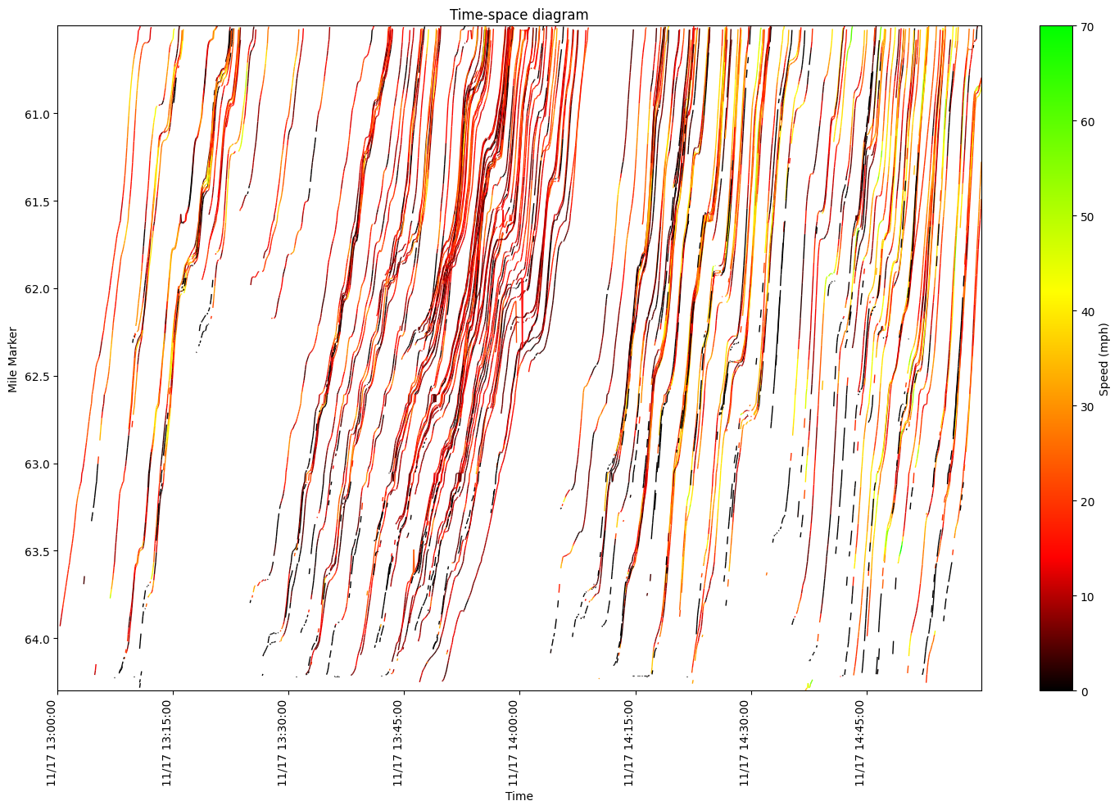
More Failures…
DESTION 2025 Irvine, California

Slide 30
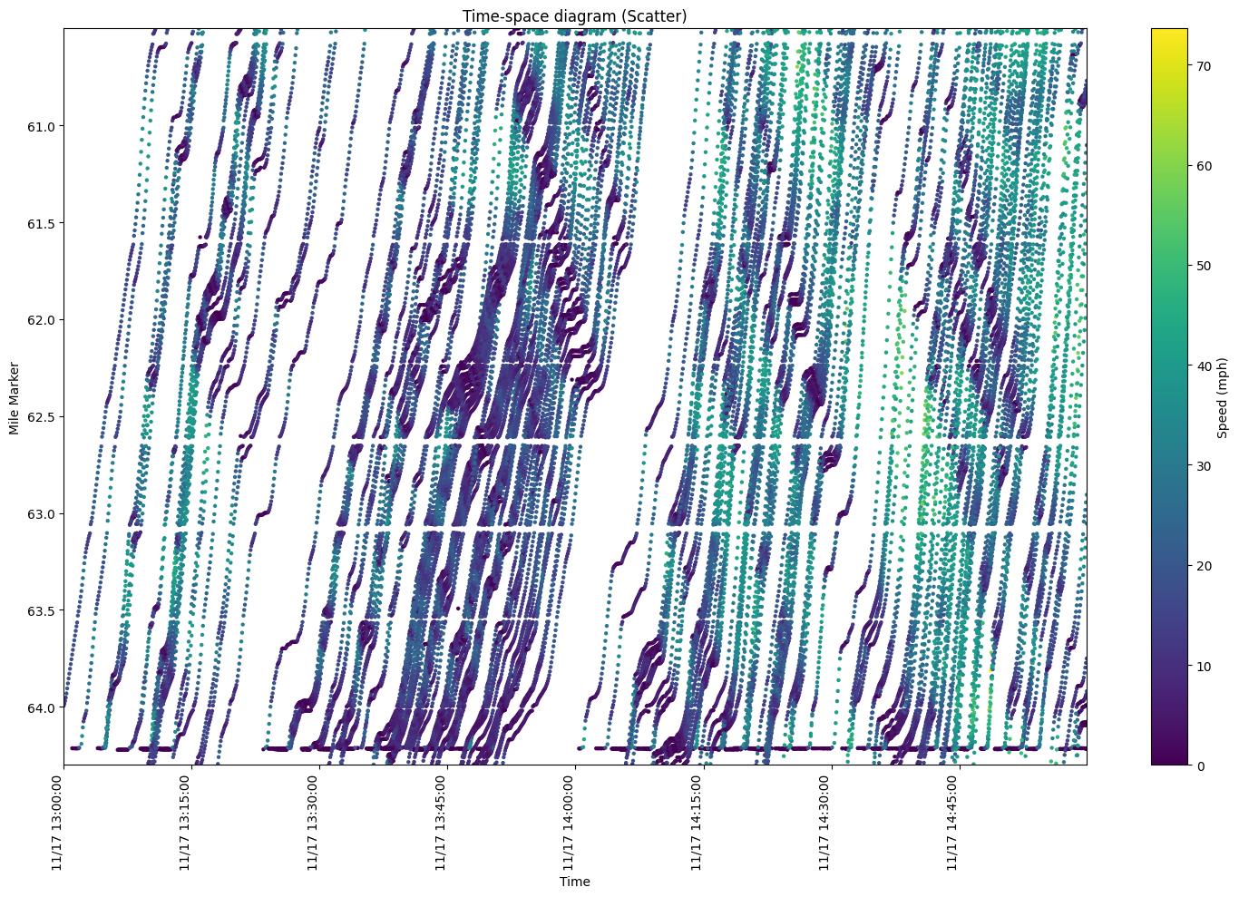
Success!
DESTION 2025 Irvine, California
Notes:
Scatter plots helped address the connection of traces between runs. Interpolation issues are clear.

Slide 31
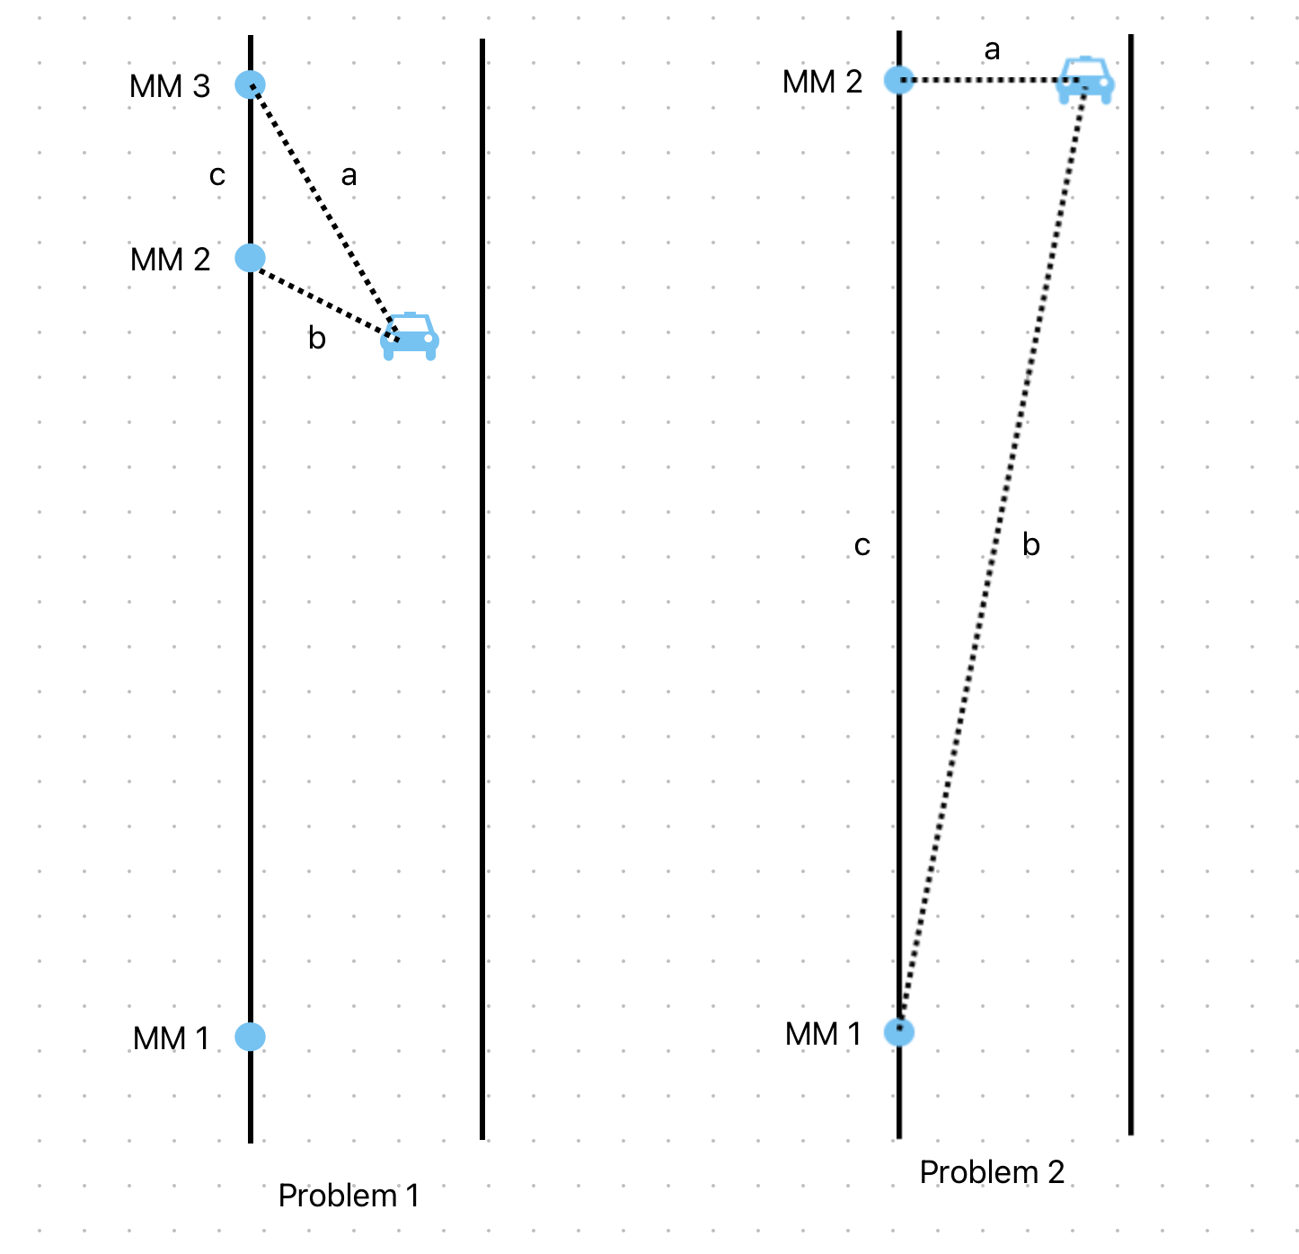
Remaining interpolation issues
Inconsistent MM points result in selection of undesired nearest points. Solved by factoring in bearing to points.
Failure to project position along MM path results in never interpolating position at points
DESTION 2025 Irvine, California
Notes:
Solving the second was taking too much time and abandoned as out of scope for this study

Slide 32
Is it fast enough for online exploration?
We put together a POC using a single page Dash app with help from ChatGPT…
DESTION 2025 Irvine, California

Slide 33
Video of Dash app running is here: https://youtu.be/weDuBX7xbQg
DESTION 2025 Irvine, California

Slide 34
Goal Review
Simplify storage of the dataset
Better handle mixed-frequency multi-modal data
Improve query speed
Revise analysis routines for efficiency
Enable web-based exploration of data
DESTION 2025 Irvine, California

Slide 35

Lessons Learned
Tool selection matters
Database
Development/testing
Efficiency is significant at scale
IoTDB syntax is in flux and can be quite challenging
Architecture is important
Perform operations where they make the most sense
DESTION 2025 Irvine, California

Slide 36
Future Work
IoTDB offers many more functions to explore
Dash POC needs to be extended into a proper website with different forms of data to explore
Explore clustering and parallel processing Compare other databases
DESTION 2025 Irvine, California

Slide 37



Thank you to the contributors for their assistance and foundational research:
Repository: https://github.com/srees/PIoTDB_csv
stephen.a.rees@vanderbilt.edu
DESTION 2025 Irvine, California

